Slide 1

West Yorkshire ICB’s
Maternity Inequalities Dashboard
Duncan Cooper
Duncan.Cooper4@nhs.net
Programme Analyst
West Yorkshire Integrated Care Board – West Yorkshire & Harrogate Local Maternity System

Slide 2
Looking at Measures like these:
Maternity Health inequalities dashboard – LMNS wide and local too
Smoking at Time of Delivery
Smoking at Time of booking
Smoking Quit Rates
Breastfeeding Initiation
Skin to skin contact
Continuity of carer
Stillbirths (but small numbers!)
Preterm births
Late booking
Teenage Pregnancy
BMI at booking
Employment
Complex Social Factors
English not first language
Labour Complications
Induction of Labour
Birth Weight
And More
By population groups like these:
Trust Booked at/ council area live in
Age Cohort
Ethnic Background
Deprivation of residence
Geographic Ward
Registered GP/PCN

Slide 3
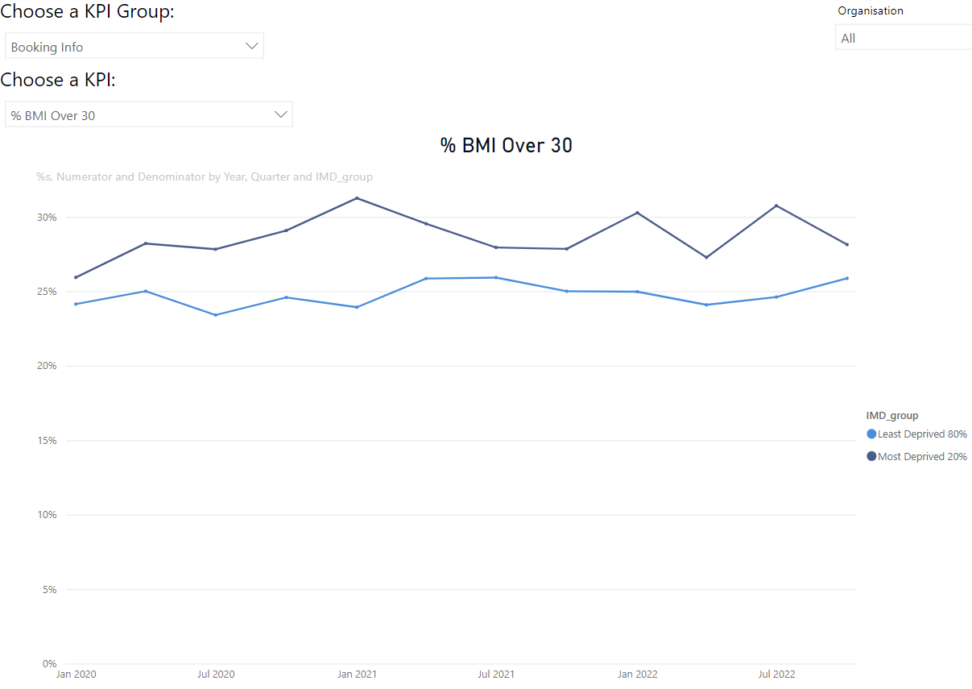
Examples:
BMI Over 30 by most and least deprived Over Time

Slide 4
Aims
At an LMNS and local level:
Improve understanding of population groups
Identify differences in health and care by population group
Identify geographically highest need areas
Evaluate interventions over time – are we making a difference?
NHS, Local Authority and public health colleagues in West Yorkshire and Harrogate can request access to the full dashboard at this link

